Slide 1

SMART Mobility: Urban Science (US) Pillar
Emerging Technology Adoption Across Settlements and Populations – A SMART Mobility Typology
PI Patricia Romero-Lankao, Douglas Nichka (Mines), Andrew Duval, Daniel Zimmy-Schmidt, Caro Neri (Mexico), Joshua Sperling, Clement Rames, and Alana Wilson

Slide 2
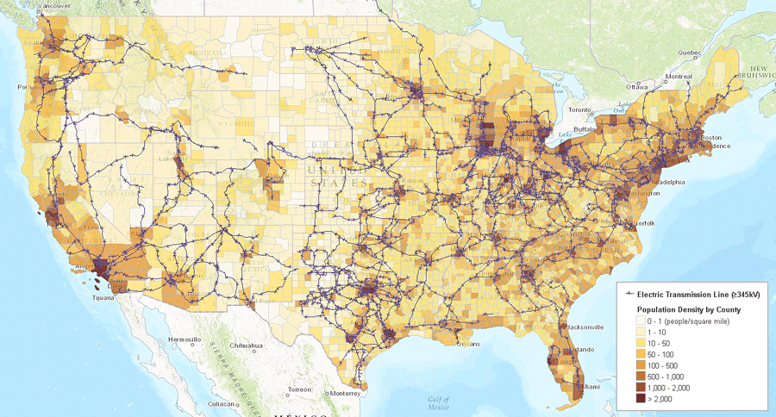
Typology to identify clusters of features in emergent transportation behavior & energy use across settlement types & socioeconomic status groups
How transferrable are results from one city to others?
Source: U.S. EIA
Notes:
The ability to classify urban areas in ways that facilitate predicting how they will respond to new technologies is critical to understanding how new technologies will impact the energy efficiency and resiliency of urban areas.
What is out there:
Typology of cities globally by MIT and by a group of international scholars
Solecki, W. et al. A conceptual framework for an urban areas typology to integrate climate change mitigation and adaptation. Urban Clim. 14, 116–137 (2015).
Romero-Lankao, P., Tribbia, J. L. & Nychka, D. Testing theories to explore the drivers of cities’ atmospheric emissions. AMBIO J. Hum. Environ. 38, 236–244 (2009).

Slide 3
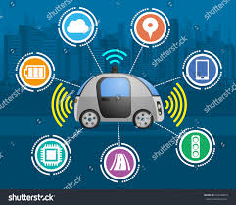
I. Objectives
Enhance value of SMART Mobility
Transferability and AGM
Create a multi-dimensional typology of adoption and impacts
E.g. on energy & infrastructure
Analyze how SETEG indicators relate with adoption and impacts
E.g., demographics, density
Notes:
Enhance the value of SMART Mobility efforts by making relevant outcomes transferable between settlements sharing similar characteristics;
Create a multi-dimensional typology of adoption and impacts of emerging technologies – for instance on energy and infrastructure;
Analyze how socio-demographic, economic, techno-infrastructural, environmental and governance (SETEG) indicators correlate with patterns in emergent technology adoptions and its impacts.

Slide 4


II. Methods and data
Systemic literature review
Data on (SETEG) indicators
Standard statistics
Cluster analysis
Correlations among population clusters (persona) & settlement type
Notes:
Build on existing literature and our prior work, to create indicators describing the multidimensional SETEG factors associated with differences in technology adoption and its impacts.
Conduct a standard multiple regression approach with log-transformed variables as described in standard applied regression literature.
Conduct either threshold regression or hierarchical cluster analyses. We will start with a focus on 10 states and will expand the study to all US states in FY2020.
Group settlements and populations into high, medium and low adoption and impacts clusters. We will run tests for spatial autocorrelation to measure the geographic clustering of each of the input indicators.

Slide 5
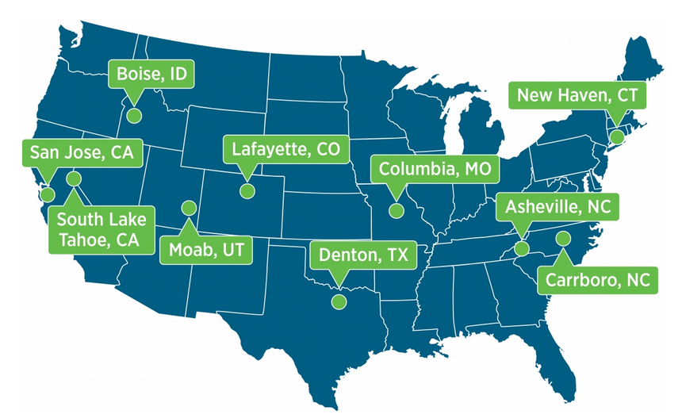
Data SMART -> Cities LEAP -> Robust Multi-Layer Typology Resource

Slide 6
Why SETEG indicators? Example of Prior Work: OLS Coefficients Variables Predicting Total Transportation Energy Use at the City-Level for 84 global cities
*p<.05 **p<.01 ***p<.001
Source: Romero Lankao, Tribbia and Nychka (2009). Ordinary-least-squares (OLS) regression estimating elasticity of each independent variable.
Notes:
In prior work, we employ ordinary least squares regression to test three theories at the city level ecological modernization, urban transitions, and human ecology. With the exception of population, a remarkable level of variation exists in the importance of drivers across the three exercises. This led us to conclude that urban atmospheric pollutants and energy use in the transportation sector are the outcome of diverse sets of socio-demographic, economic, techno-infrastructural, environmental and governance (SETEG) drivers. We highlight these findings in the next two slides.

Slide 7
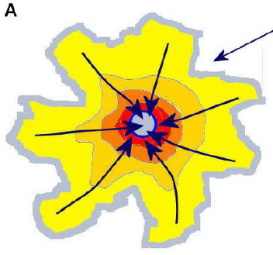
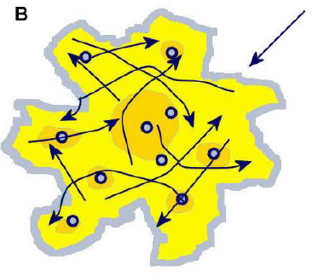
SETEG interacting predictors of transportation energy use in cities
Transportation mode share
1% increase in public transport results in 0.15% decrease in energy use
Settlement type
1% increase in density results in a 1.25% decrease in energy use
Mono-centric
Poly-centric
Source: Romero Lankao, Tribbia Nychka (2009). Database covering 84 cities, regression estimating elasticity of each driver

Slide 8
IV. Testing Statistics in CO
PCs to select 2 age variables
Clusters on 7 variables
K Means clustering: clusters on centered and scaled variables
variables for about 3500 block groups are
"population" "populationDensity” “white”
"income" "ageFemale25X49"
"white" "ageMale25X49"
Notes:
Attached are some plots for looking at the CO demographic data.
Full set of variables for about 3500 block groups are
[1] "population" "populationDensity"
[3] "intersection" "income"
[5] "white" "ageMale25X49"
[7] "ageMale50X64" "ageMale65X"
[9] "ageFemale25X49" "ageFemale50X64"
[11] "ageFemale65X"
I took the Age variables and just used the first 2 PCS of them. Thus I did the clusters on just 7 variables, the last two derived as PCs from the Age percentages.
Found 4 clusters on the centered and scaled variables using k Means clustering.
Here are some plots showing some of these results athough there is much to do in terms of interpretation.
First is the variance explained by the original 11 scaled variables by PC.
Note that 4 components explain more than 90% of the variance.
Second plot is a scaling of the variables into two psuedo coordinates to show how the clusters are structured. The colors are the four clusters. This is easier to see in 3-d. Basically there are 3 places where the point cloud sticks out in a point and those are distinct clusters. The 4th is added onto the more central portion.
Third took a long time to get the functions set up but now I can do this easily.
This a downloaded google map of Boulder/North Denver with the centroids of the blockgroups color coded by the cluster type. The magenta lines are the actual block group boundaries. Some of the centroids do not seem to be in the "centers" but I can fix this in the future. I think the way the clusters are distributed in Bulde these could make sense and be interpreted.
Last one are the clusters for all of CO.
OK we can talk about this more tomorrow and I can fill in more details for your group meeting this week.

Slide 9
Four clusters Front Range CO
Here are some plots showing very preliminary results Note that there is much to do in terms of interpretation
* No spatial autocorrelation analysis will be necessary

